Slide 1
A Programme Advisory Engine
HCI Project 2
Tasneem Abed (1408535)

Slide 2
Idea
To help decrease failure rates in the Science Faculty, this system is for new incoming students to get an idea of how their academic trajectory may play out given a course they pick and some background, individual and pre-university information.
The model used is a decision tree.

Slide 3
Needfinding
Conducted a survey with 43 participants
All participants were university students

Slide 4
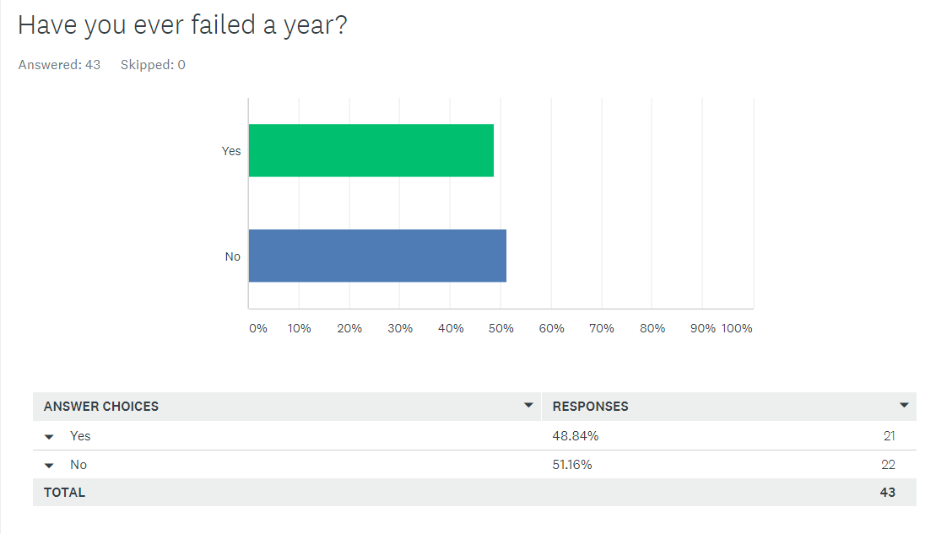

Slide 5
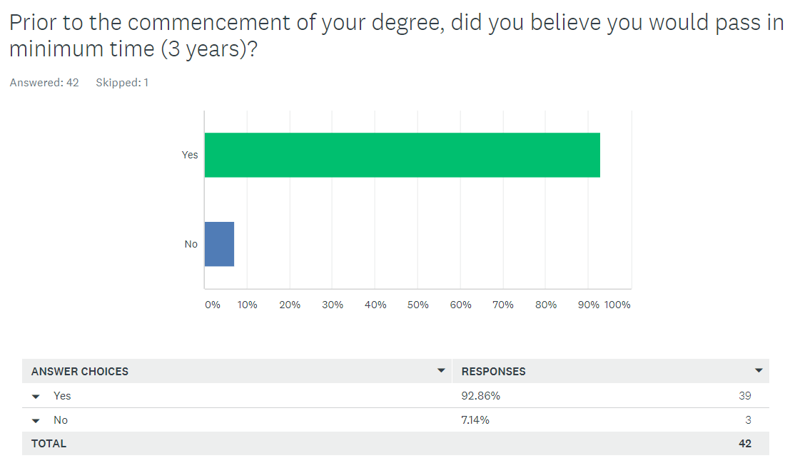

Slide 6
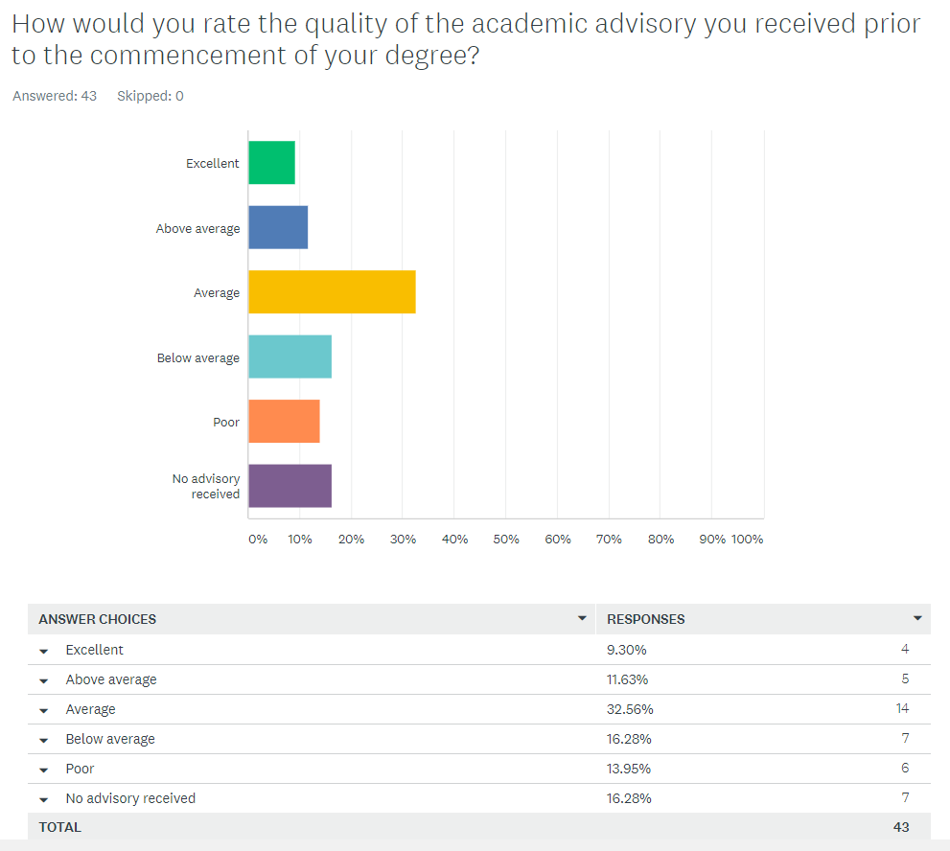

Slide 7
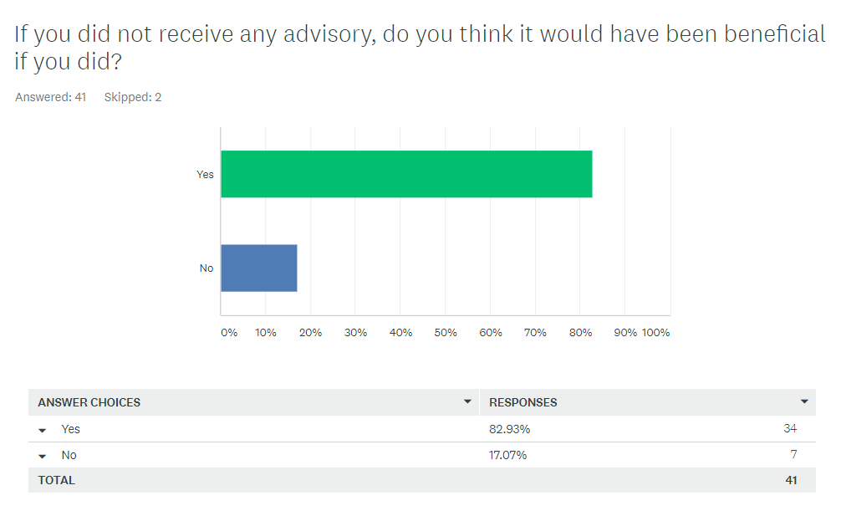

Slide 8
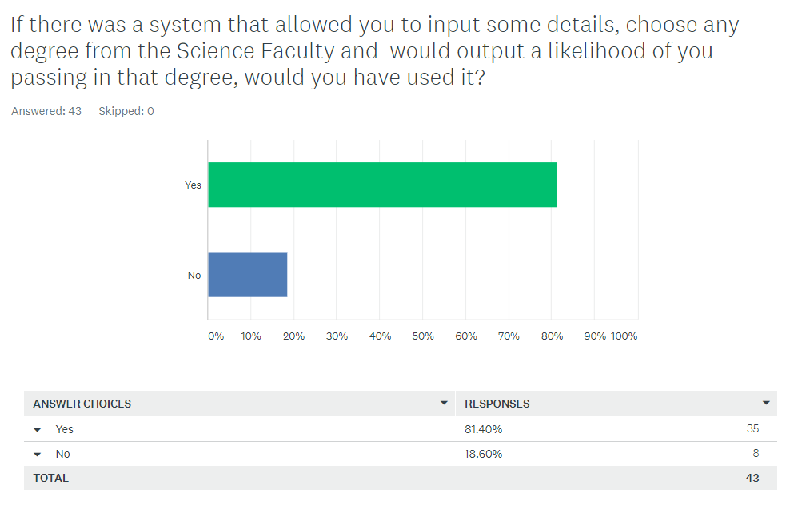

Slide 9
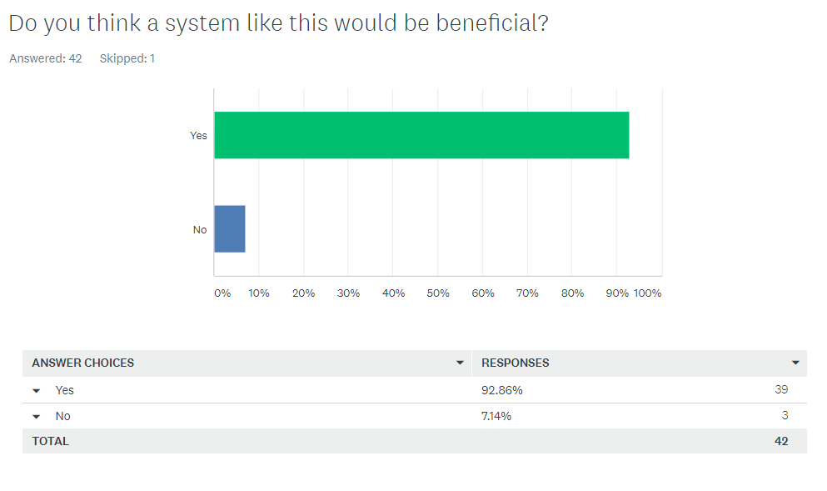

Slide 10
Results of needfinding
Needfinding reveals that there is a need for better academic advisory that should be readily available to all students

Slide 11
Design Alternatives
Less interactive application. The university has these details so no app is needed, the results can just be conveyed to the student.
The app is not for the student but rather for an advisor who views the results and talks to the student about them

Slide 12
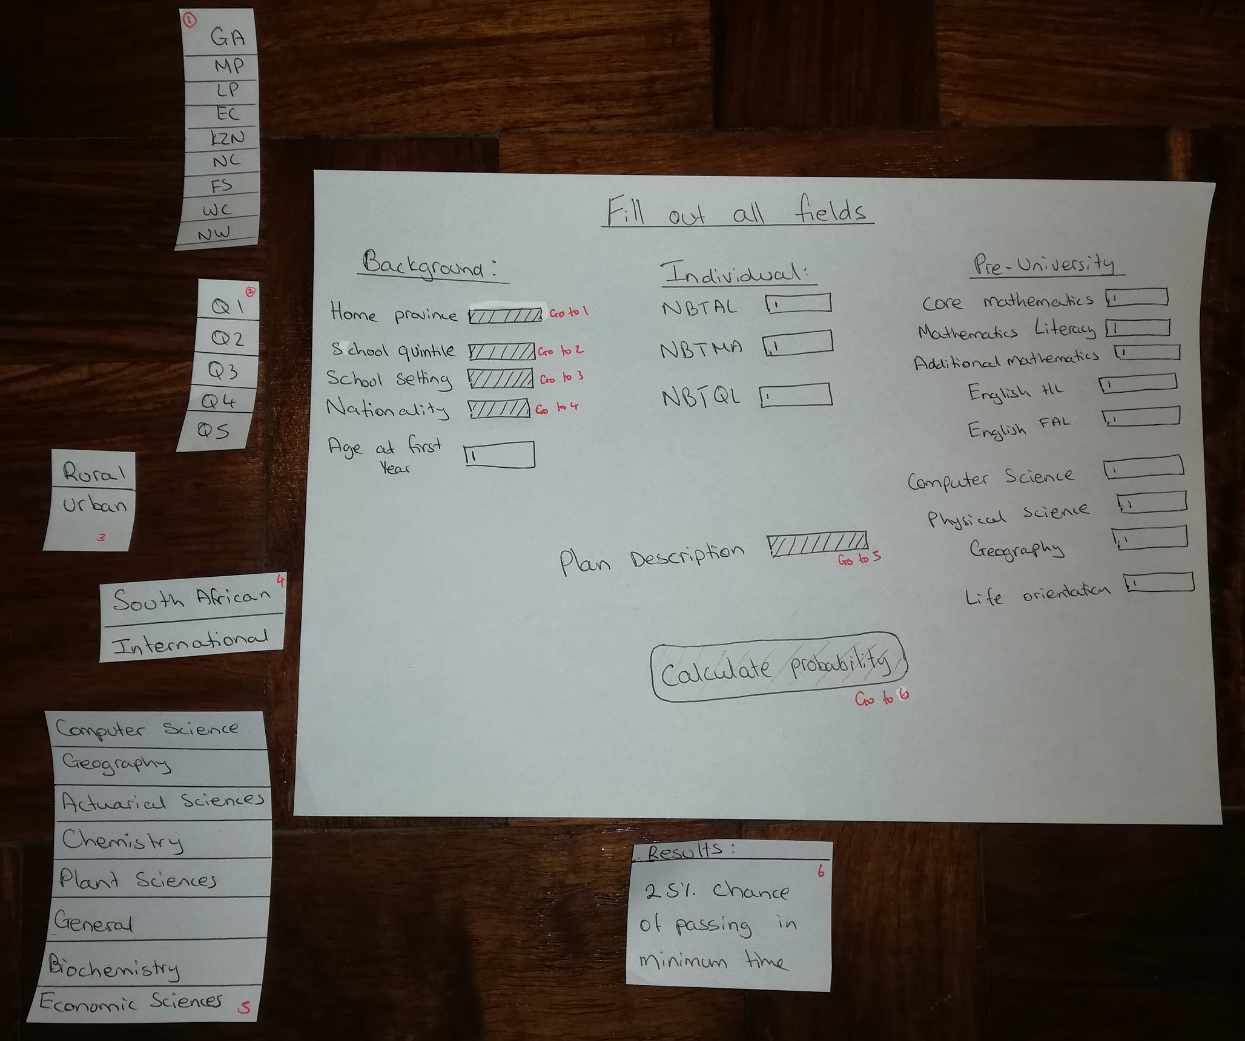
Prototype 1
Paper prototype

Slide 13
Prototype 1 Feedback
The output should not contain numbers as it may be misinterpreted
There should be more information about the model and how the system works
‘Probability’ sounds too final
Are all fields necessary? I.e what would happen if some were left blank

Slide 14
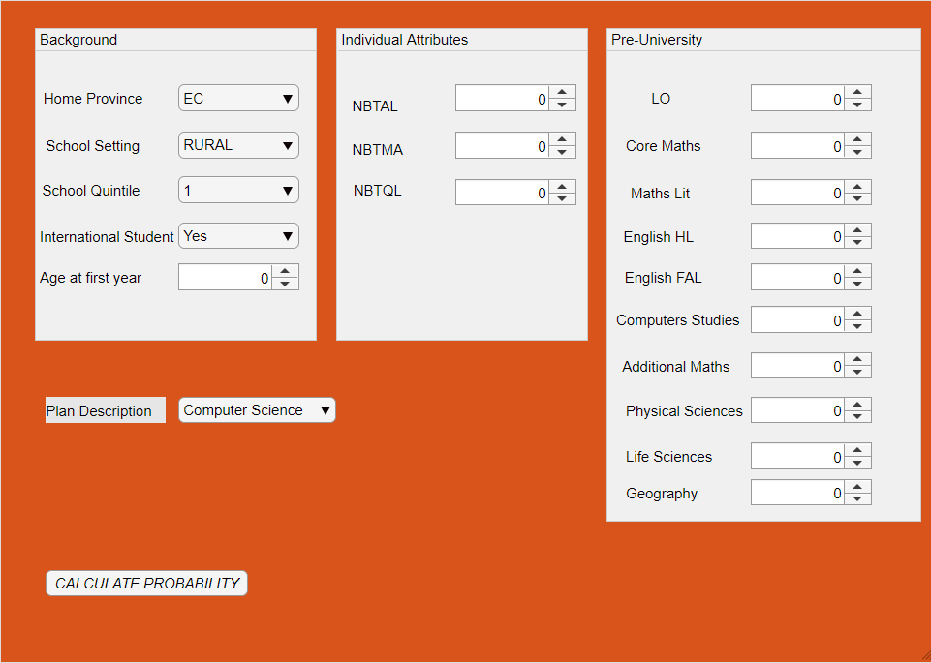
Prototype 2
Feedback
Output should be more informative
There isn’t any information regarding how the probability is calculated and how good this result is
Colours are confusing as it does not reflect Wits
What is a quintile?
Provinces should have full names
Scroller for numbers is annoying to use
Result
Failed

Slide 15
DEMO

Slide 16
Evaluation
Evaluations were done as a rating between 1 and 5 for the following criteria where 1 is very bad and 5 is very good
Efficiency
Learnability
Memorability
Satisfaction
Accuracy

Slide 17
Evaluation Results
Evaluation Criteria | Average rating
Efficiency | 5 - The system is not delayed and works well each time
Learnability | 5 - Easy to use and instructions are clear
Memorability | 5 - System is fairly basic
Satisfaction | 4.4 - The output could be improved
Accuracy | 3 - The system is only 70% accurate

Slide 18
Future Work
Testing different models to improve the accuracy
Perhaps include more features, like abstract abilities i.e. memorization skills, programming aptitude, comprehension skills etc.
Make the output better eg output a graph depicting the distribution of risk over a few degrees of a similar nature so a student can get more than what they initially bargained for
Extend the system to include all faculties

